Slide 1

Control of a Rolling Balancing System
Timothy Dunn

Slide 2
The Project
Motivation
Modelling and Simulation
Implementation

Slide 3
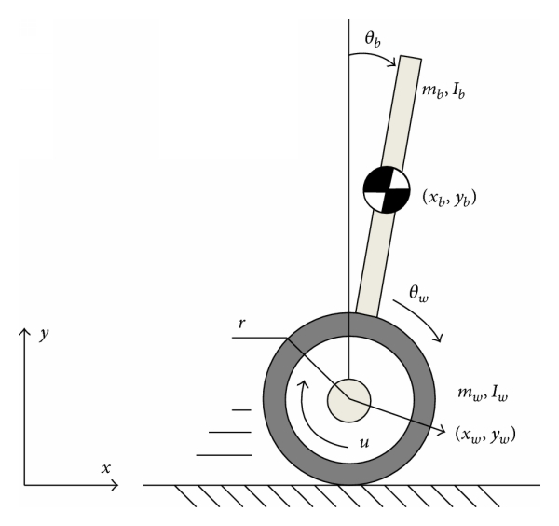
Under-Actuated Systems
https://www.hindawi.com/journals/mpe/2014/284216/fig1/

Slide 4
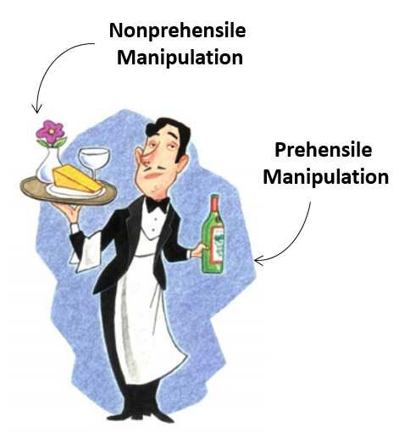
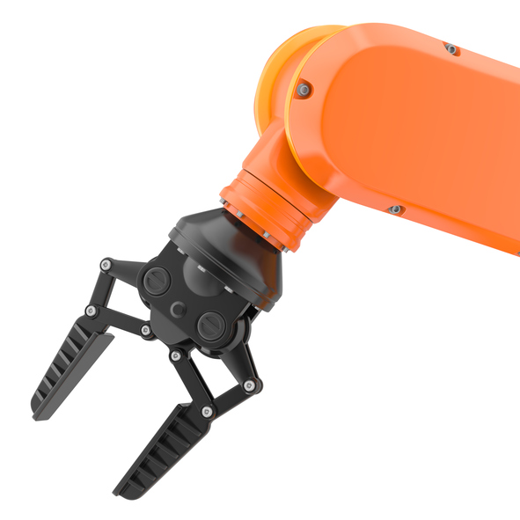
Prehensile Manipulation
https://www.researchgate.net/publication/310751102_Robot_Control_for_Nonprehensile_Dynamic_Manipulation_Tasks
https://www.robotics.org/blog-article.cfm/The-Emergence-of-Smart-Collaborative-Robot-Grippers/107

Slide 5
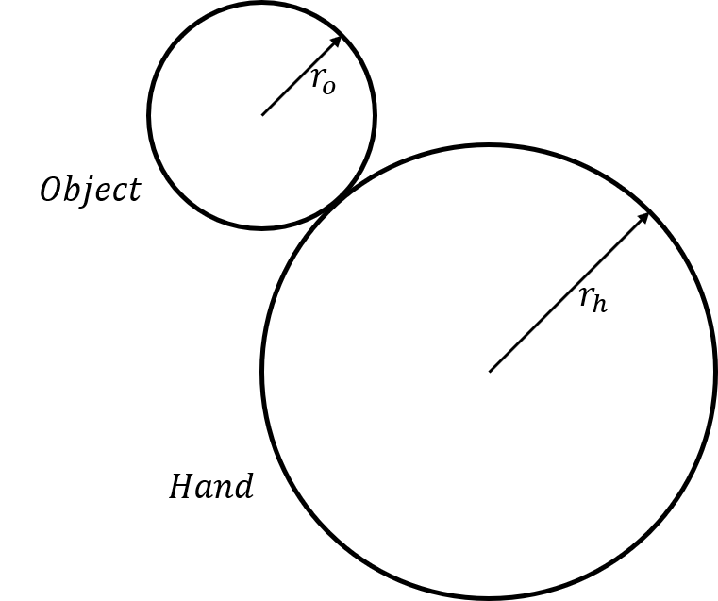
The Disk-on-Disk System

Slide 6
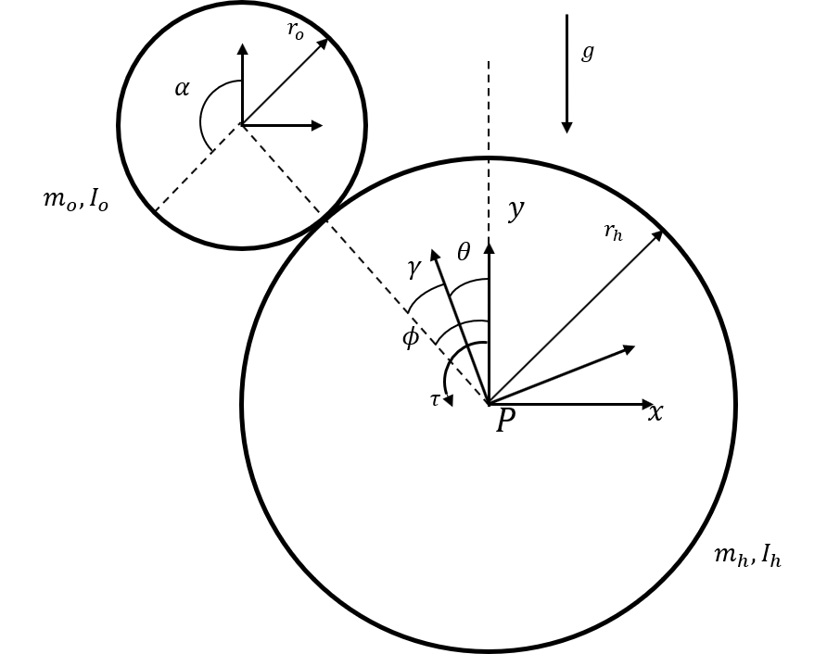
Modelling

Slide 7
Verification

Slide 8
Control
Linear-Quadratic Regulator
Setpoint tracking with reference-feedforward

Slide 9
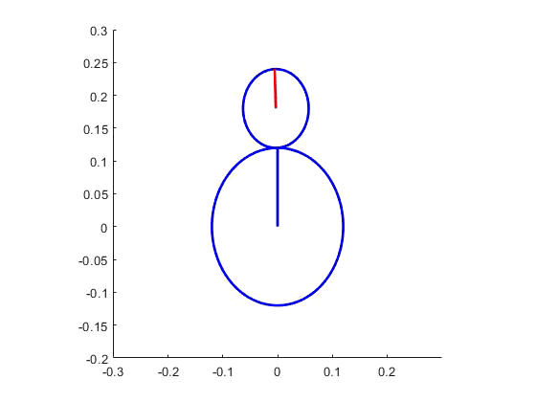
Control

Slide 10
Experiment Apparatus Design

Slide 11
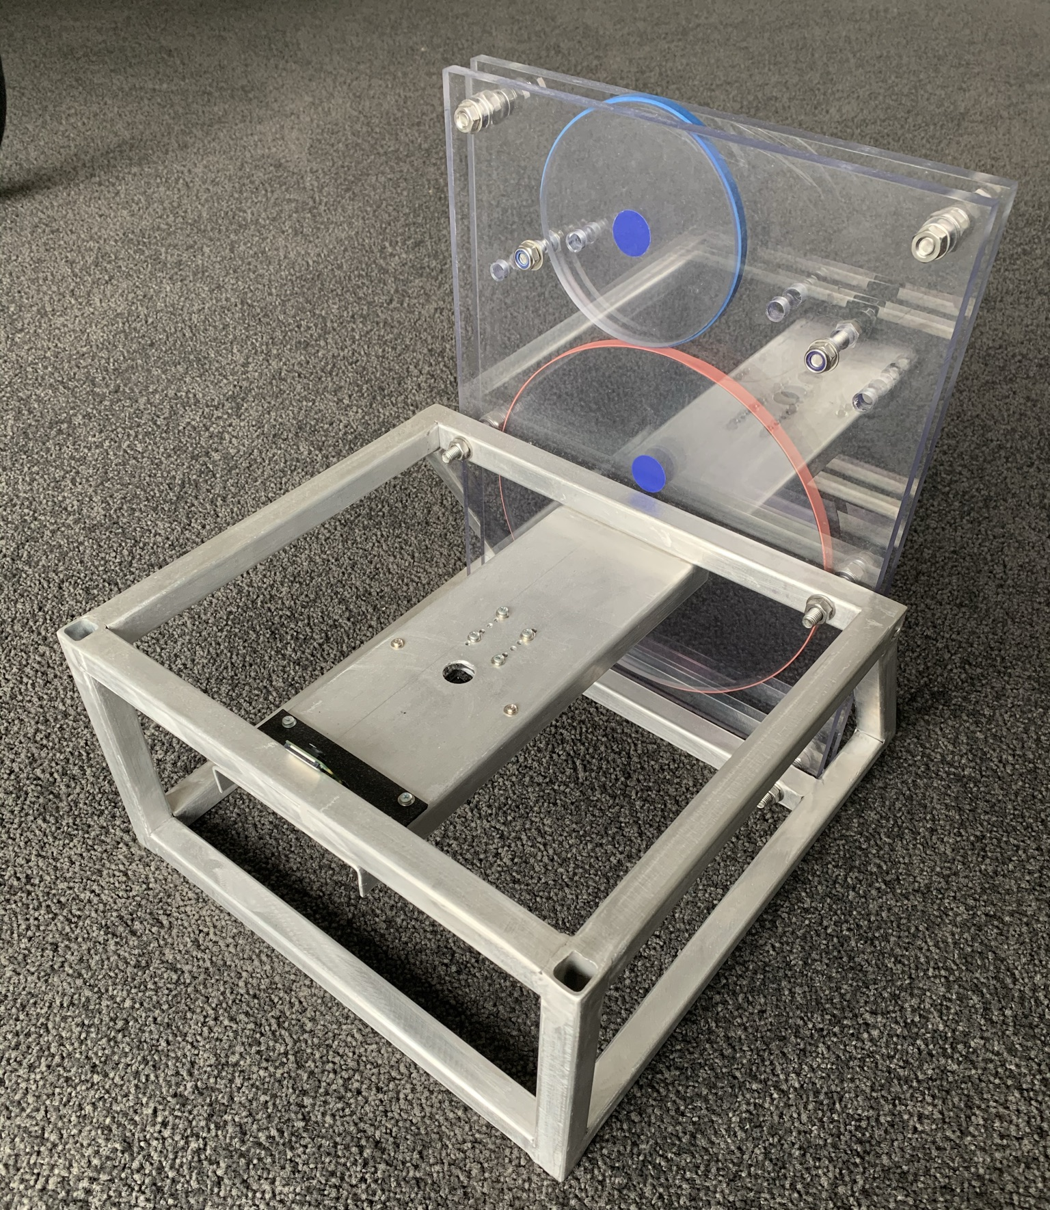
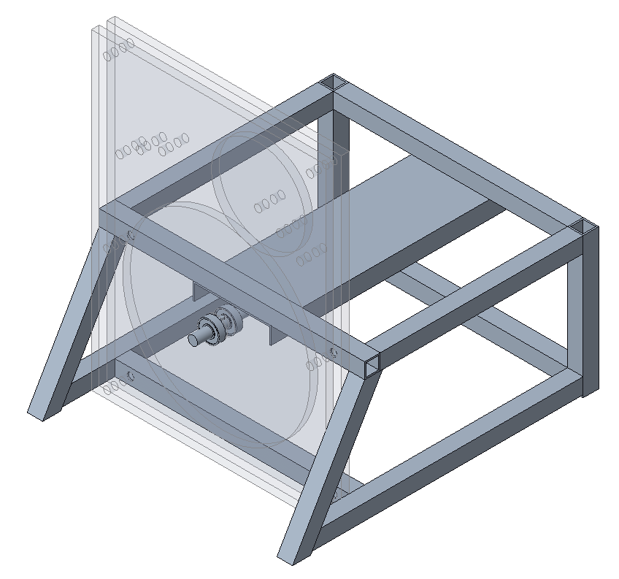
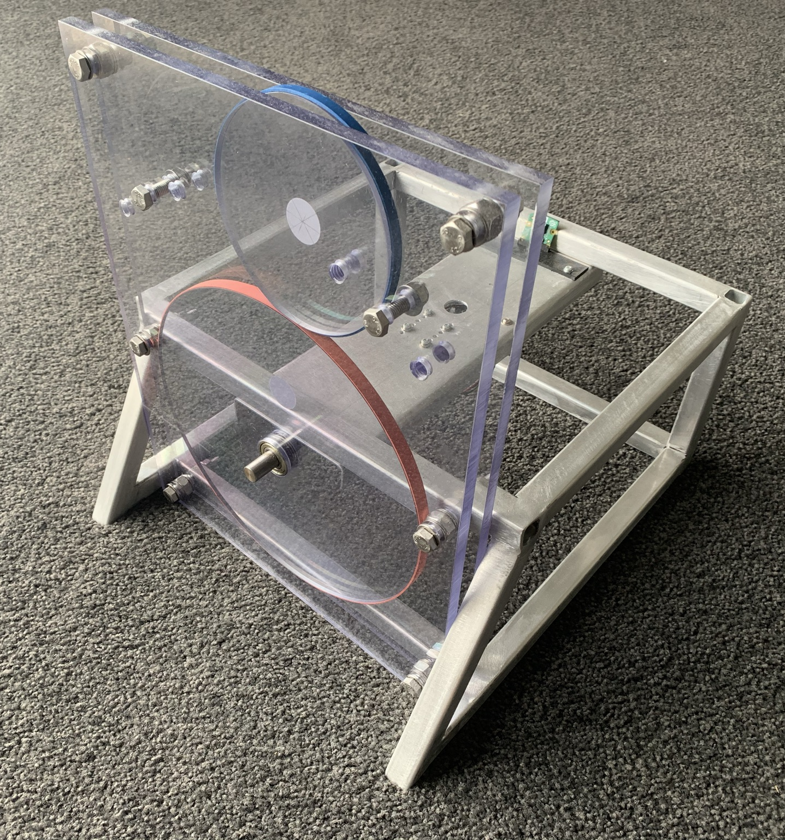
Experiment Apparatus Design

Slide 12
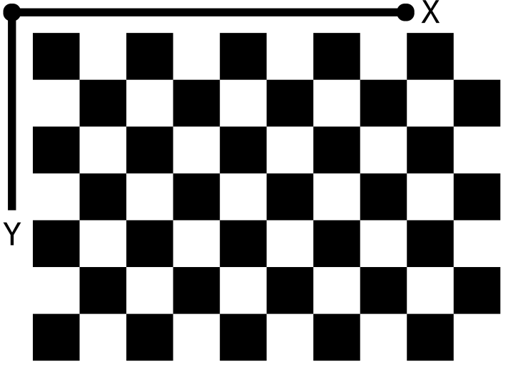
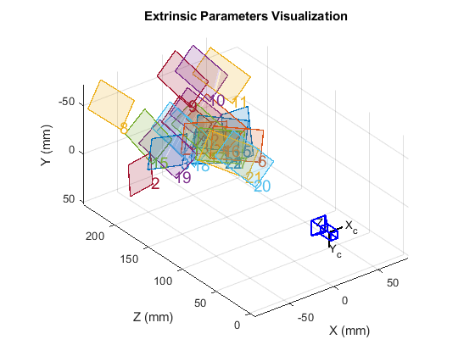
Camera Calibration

Slide 13
Image Distortion
Distorted Image
Undistorted Image

Slide 14
Reprojection Errors

Slide 15
Saturation Thresholding
Hue, Saturation and Value (HSV) Representation
Binary Representation

Slide 16
Blob Detection

Slide 17
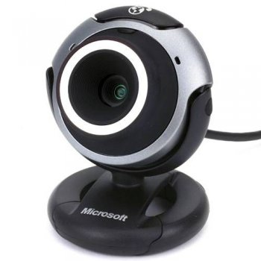
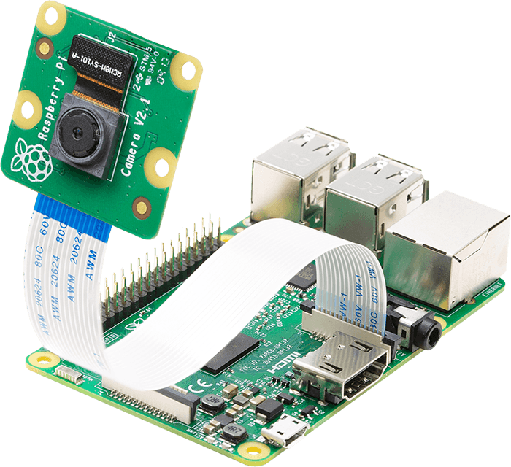
Computer Vision Implementation
Microsoft
VX3000 Webcam
Raspberry Pi
Camera
https://www.arducam.com/wp-content/uploads/2020/02/raspberry-pi-camera-pinout-camera-2.png

Slide 18
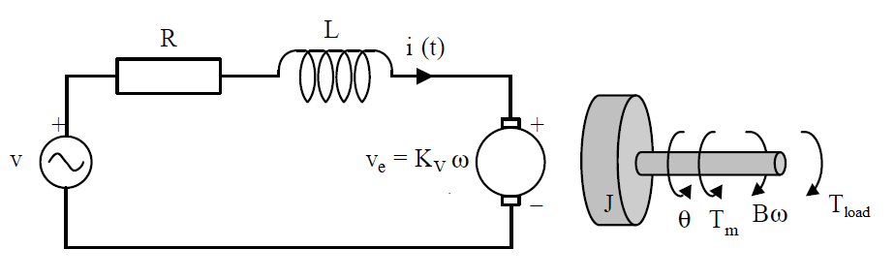
DC Motor System Identification
DC Motor Model

Slide 19
Friction Model

Slide 20
Final Motor Model

Slide 21
Proportional-Integral Control Allocation

Slide 22
Current Project Status
Implementation complete, stability not achieved
Making attempts to reduce image availability input latency

